Slide 1
Quantum Computing Architectures (EE274) Lecture 25
Hiu-Yung Wong
apr. 29, 2025
hiuyung.wong@sjsu.edu, Office: ENG363
http://www.sjsu.edu/people/hiuyung.wong/index.html

Slide 2
Outline
Charge Qubit
1-qubit gate and 2-qubit gate
Transmon

Slide 3
Analytical Solution for Cooper Pair Box
Chapter 18 of “Quantum Computing Architecture and Hardware for Engineers: Step by Step”

Slide 4
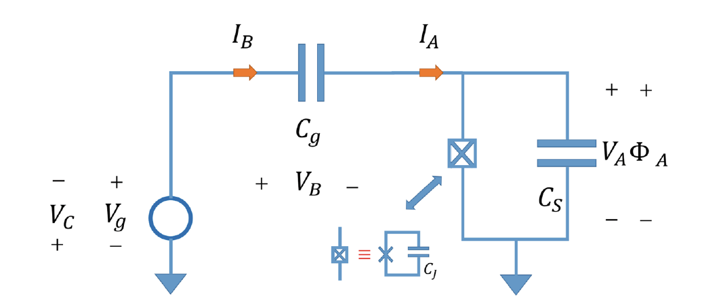

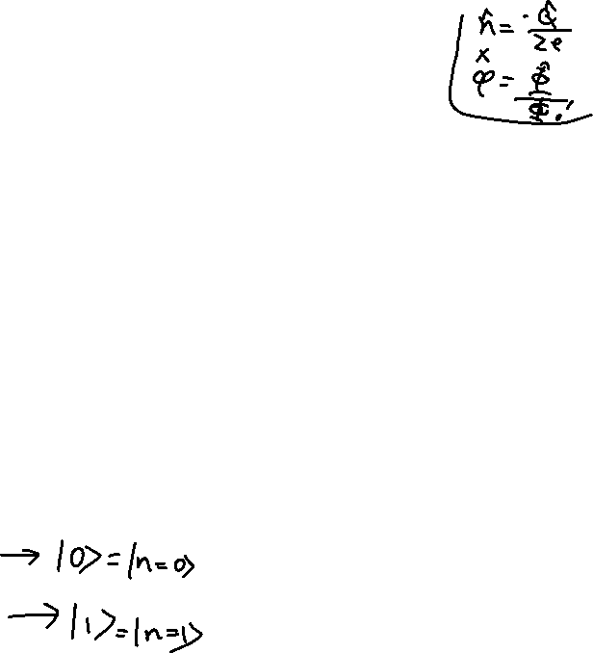
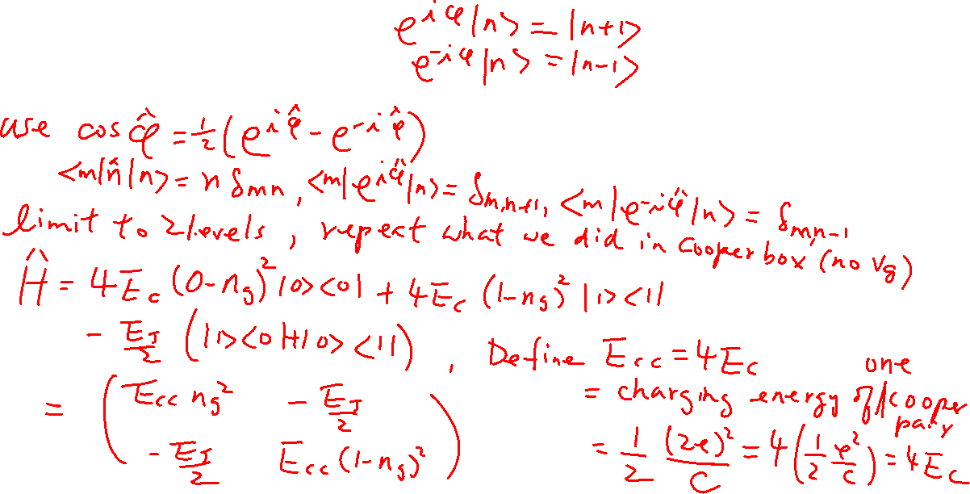
Hamiltonian of a Cooper-Pair Box with 2-level Approximation
From the last Lecture

Slide 5
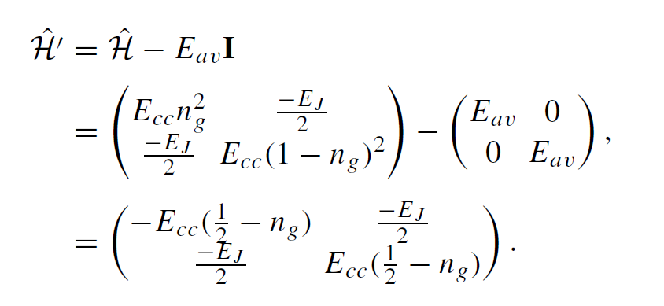
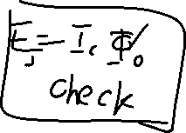
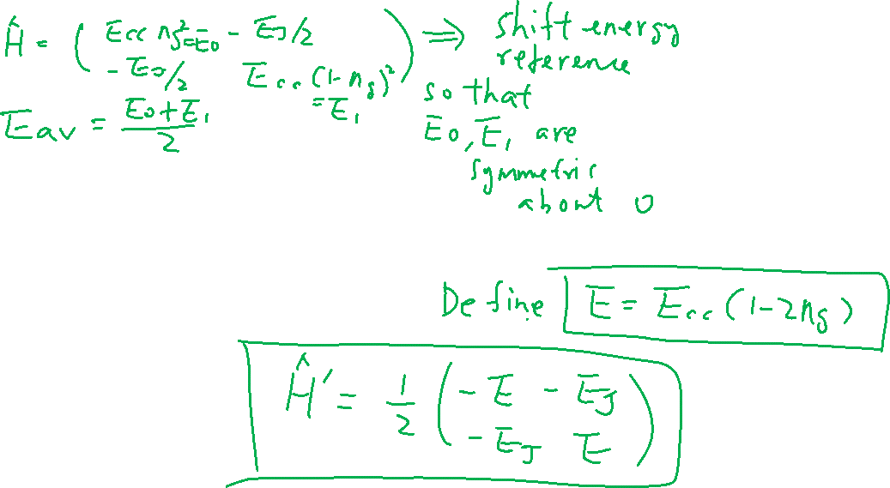
Hamiltonian of a Cooper-Pair Box with 2-level Approximation
From the last Lecture

Slide 6
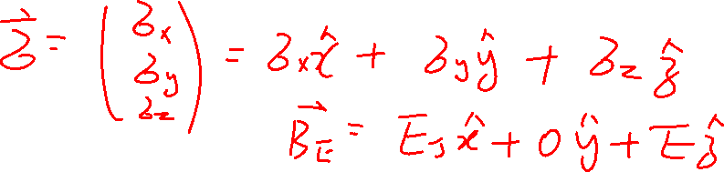
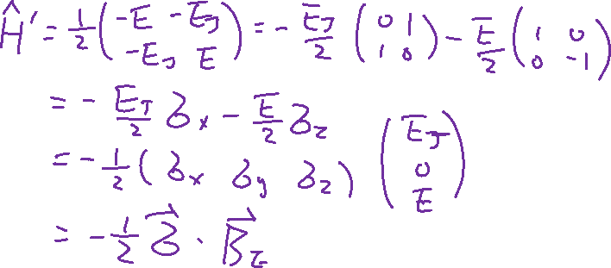
Solution of a Cooper-Pair Box with 2-level Approximation
From the last Lecture

Slide 7
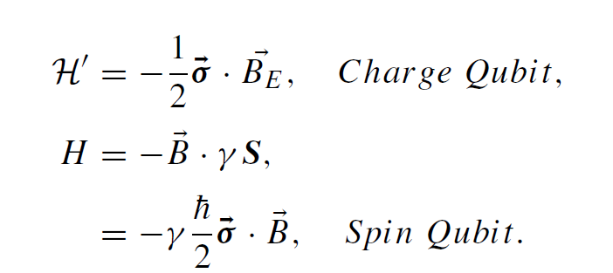
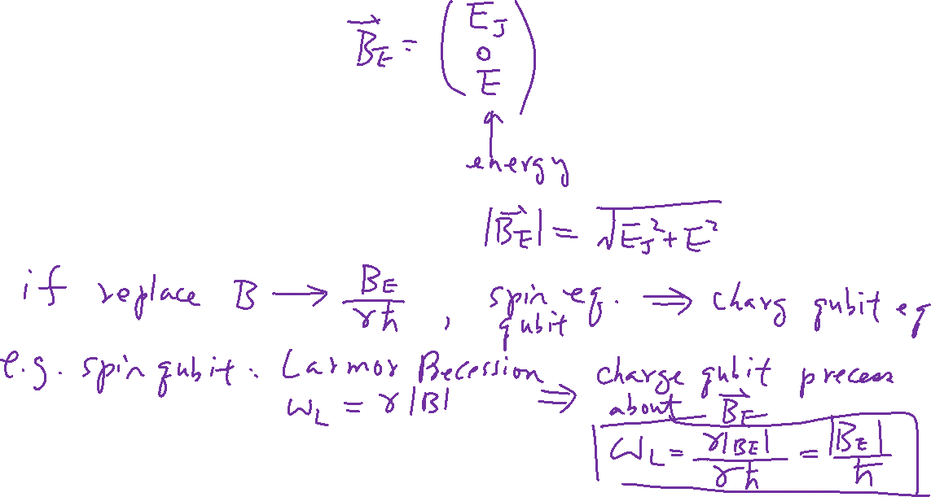
Solution of a Cooper-Pair Box with 2-level Approximation
From the last Lecture

Slide 8
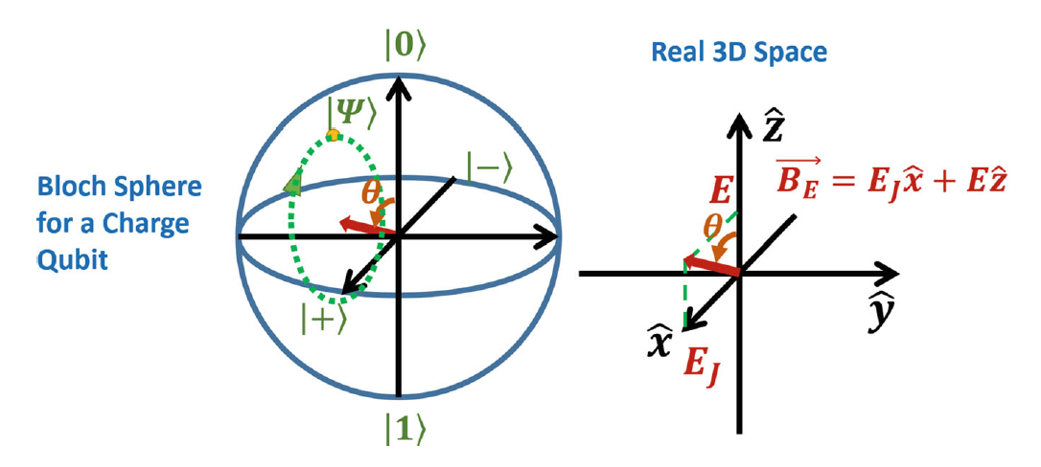
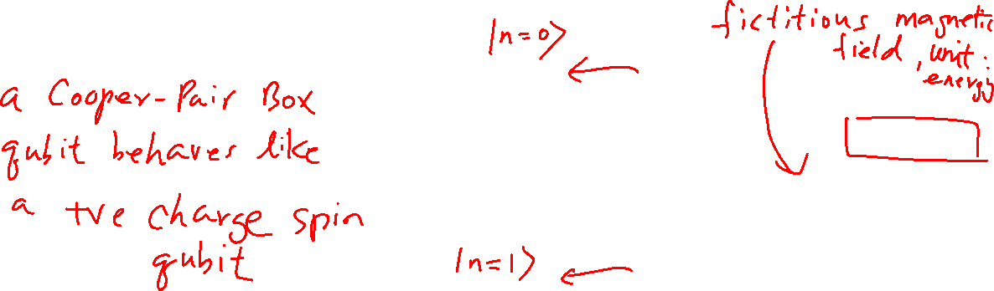
Solution of a Cooper-Pair Box with 2-level Approximation

Slide 9
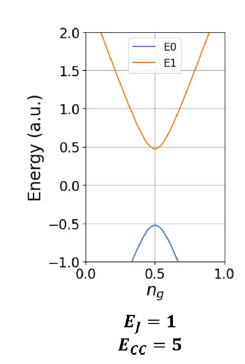
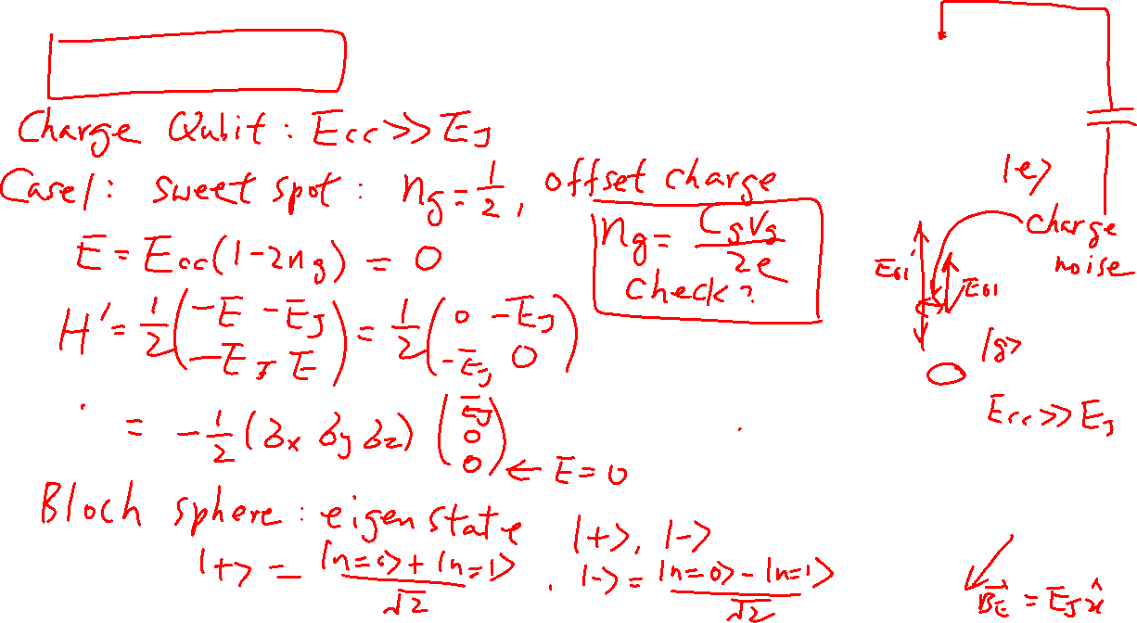
Charge Qubit at Sweet Spot

Slide 10
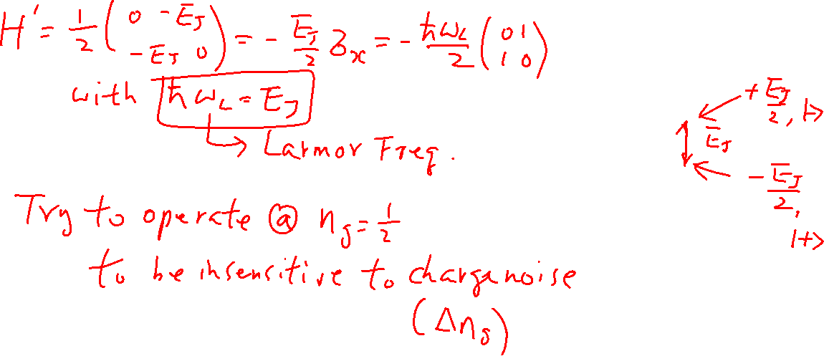
Charge Qubit at Sweet Spot

Slide 11
One Qubit Gate for Charge Qubit
Chapter 20 of “Quantum Computing Architecture and Hardware for Engineers: Step by Step”

Slide 12
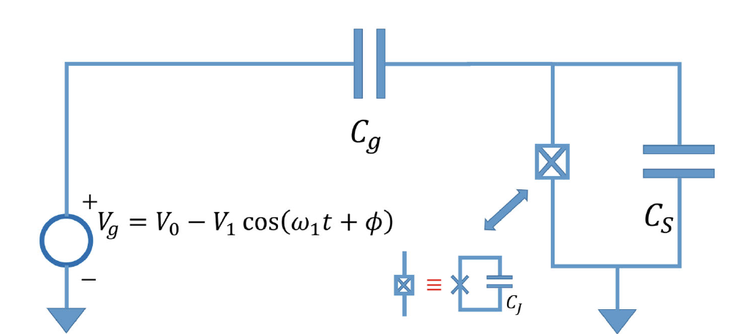
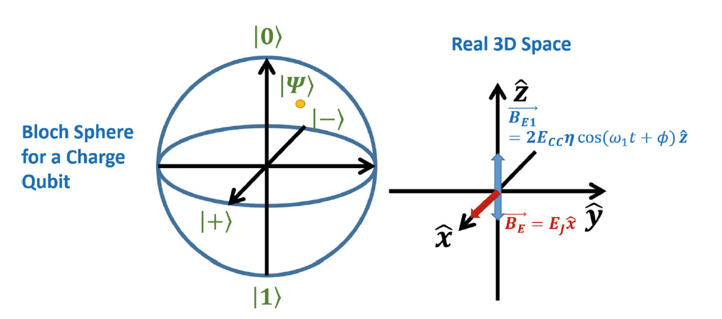
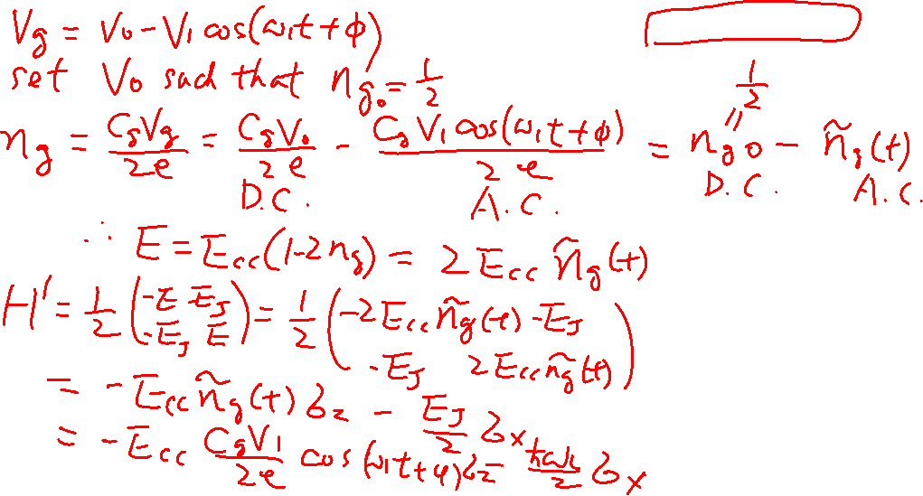
One-Qubit Gate Hamiltonian At Sweep Spot

Slide 13

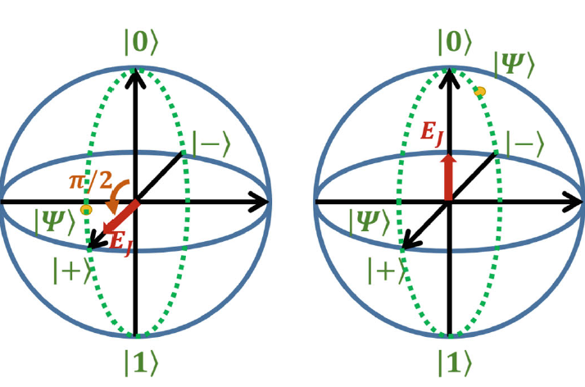

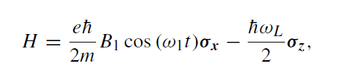
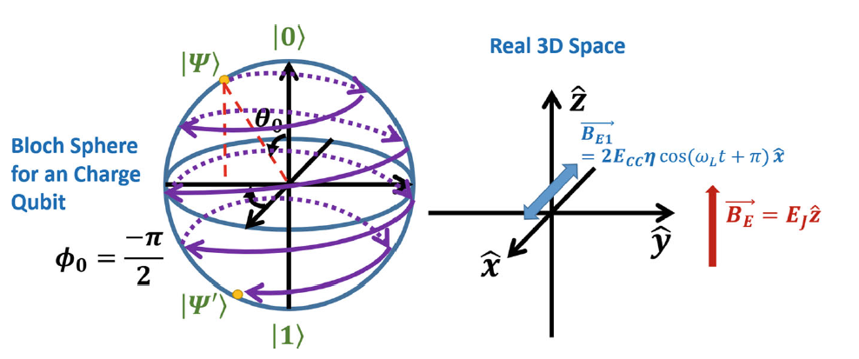
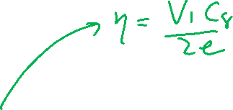
One-Qubit Gate
Transformation
Similar to Spin Qubit
The charge qubit acts like a spin qubit with a positive charge and thus rotate in the same direction as the electron with an opposite magnetic field.

Slide 14
Transmon Qubit
Chapter 19 and Chapter 21 of “Quantum Computing Architecture and Hardware for Engineers: Step by Step”

Slide 15
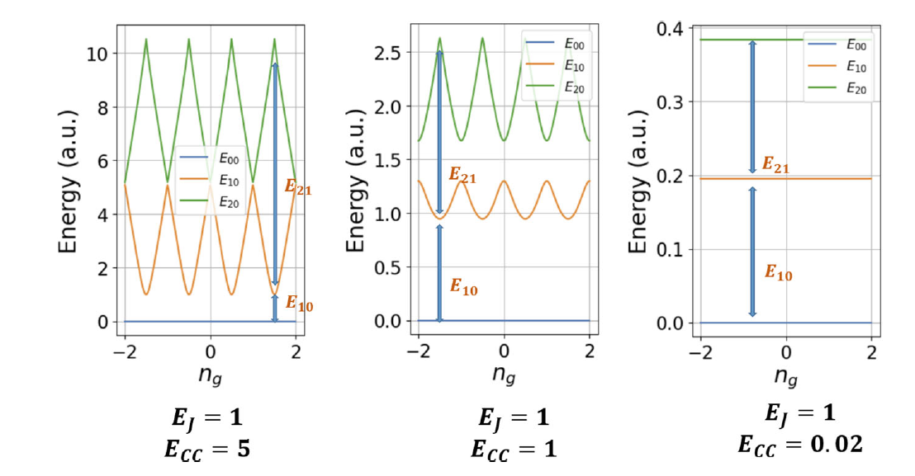
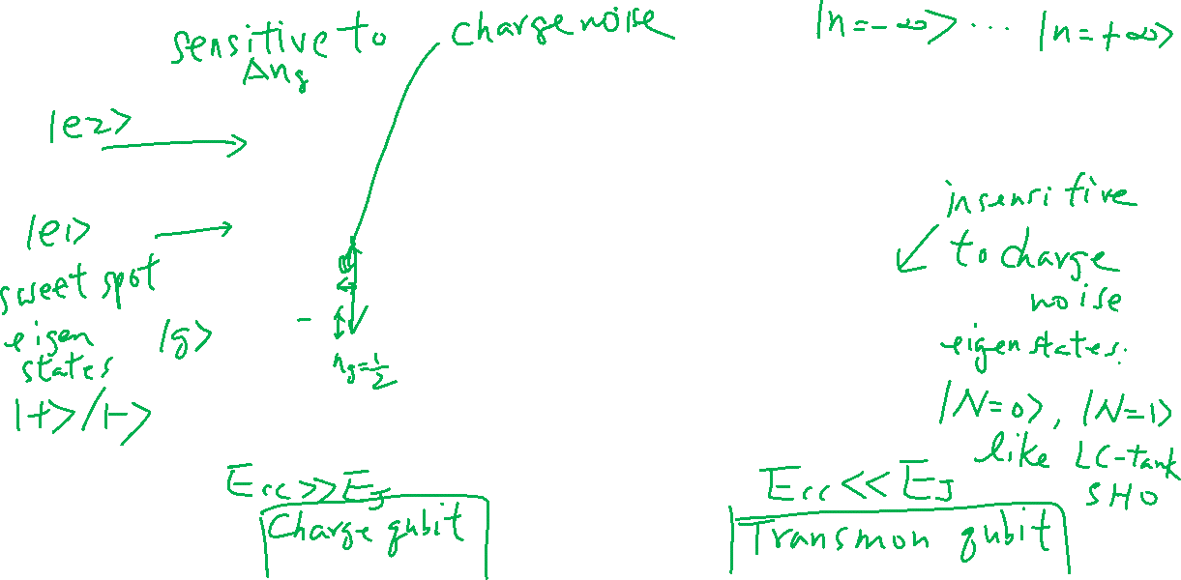
Complete Solution for Cooper Pair Box

Slide 16
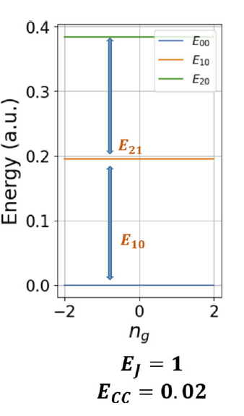

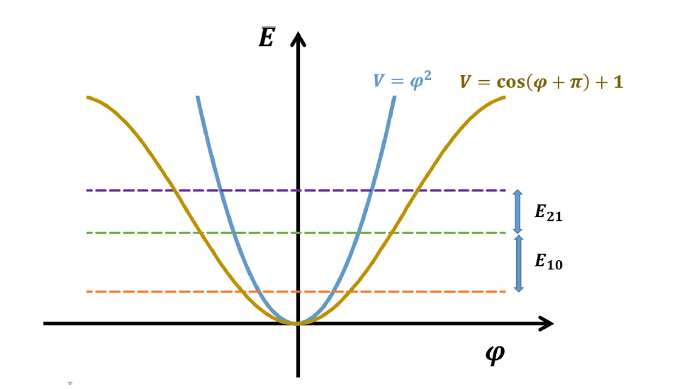
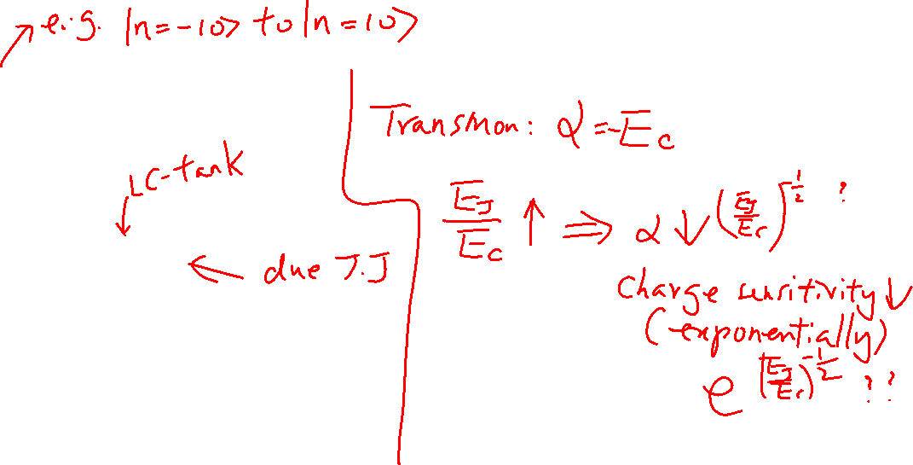
Anharmonicity
Need multi-levels to find the anharmonicity

Slide 17
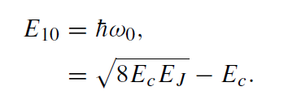
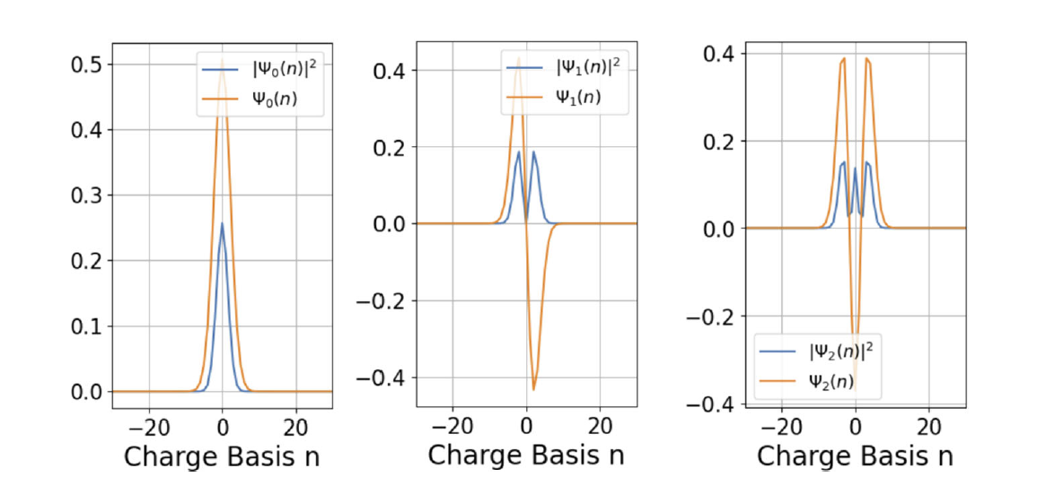
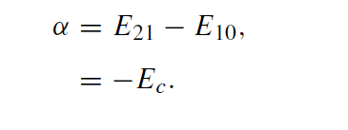
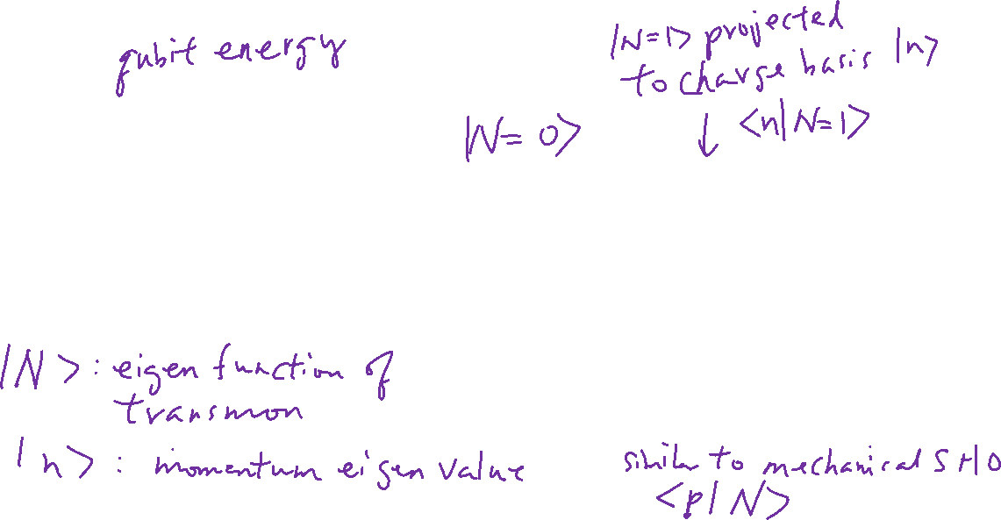
Characteristics of a Transmon

Slide 18
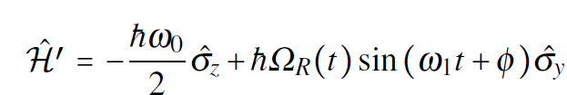
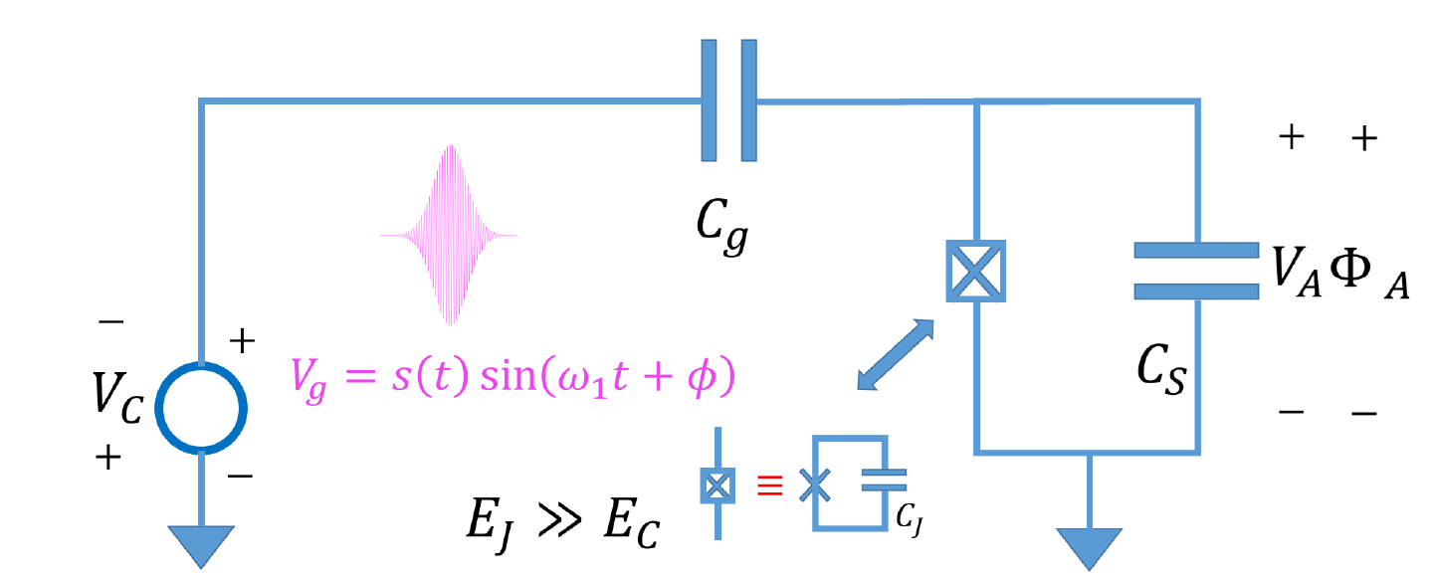
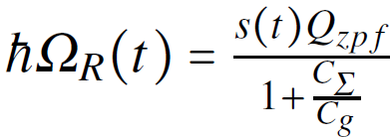


One-Qubit Gate for Transmon Qubit

Slide 19
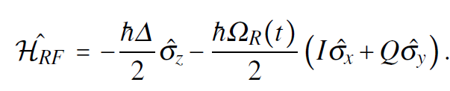
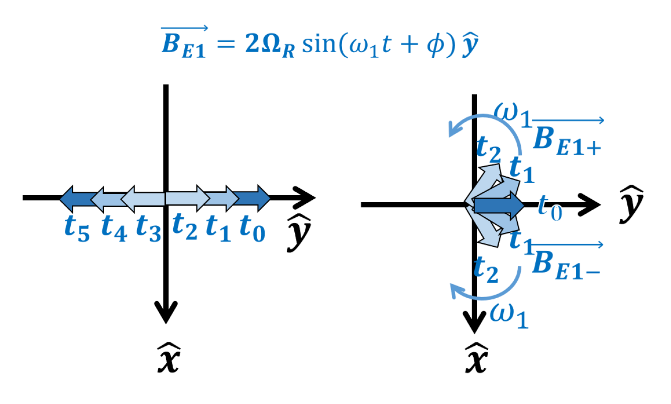
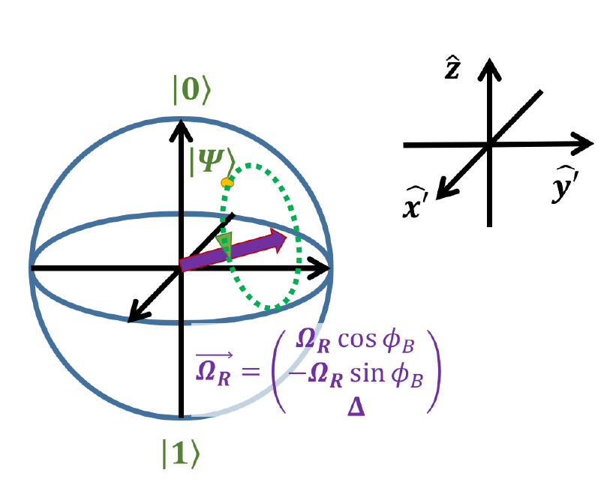
Concept of Rotating Frame and Rotating Wave Approximation
Similar to a pin qubit in a rotating magnetic field

Slide 20
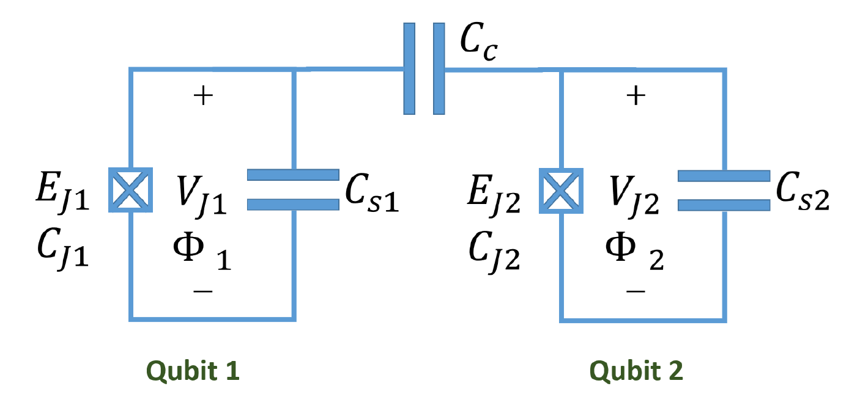
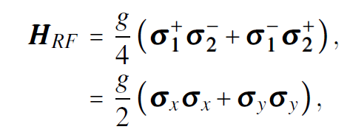
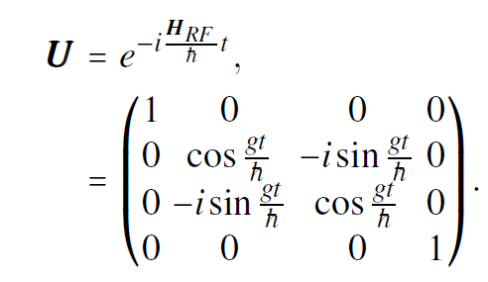
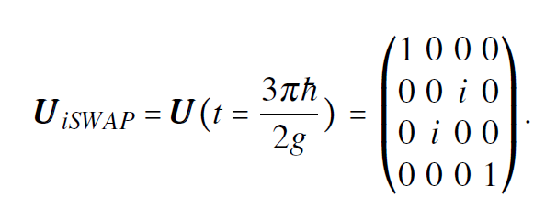
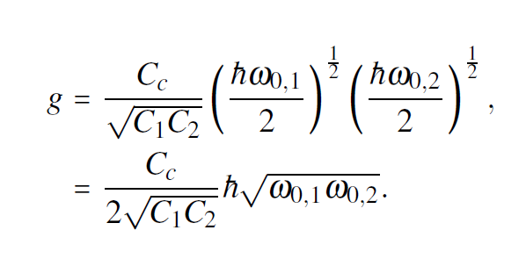
Two-Qubit (iSWAP) Gate for Transmon Qubit
The two qubit-frequencies are brought to be the same using flux tunable qubit

Slide 21
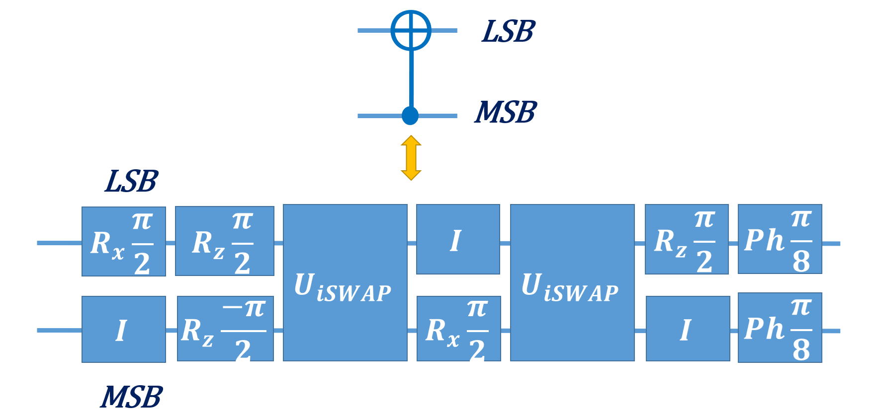
iSWAP as an Entanglement Gate

